Slide 1
AFFORDABLE HOUSING DEVELOPMENT
Group 4
Elio Aybar, Martin Copello,
Matthew Fligiel, Matt Norgren

Slide 2



Executive Summary
Affordable housing developments aid cities in promoting diversity and inclusion, improving quality of life, enriching neighborhoods, and growing the local economy. In this study, we investigate whether the locations of affordable housing developments provide positive features for its population, relating to accessibility to public transportation, amenities, active commercial scene, walkability, and general neighborhood activity.
Through our investigations, we discovered stark discrepancies between neighborhoods with a multitude of affordable housing developments and those without. Generally, areas with scarce access to transit and worse socio economic performance contain the majority of affordable housing developments.
Notes:
MC

Slide 3
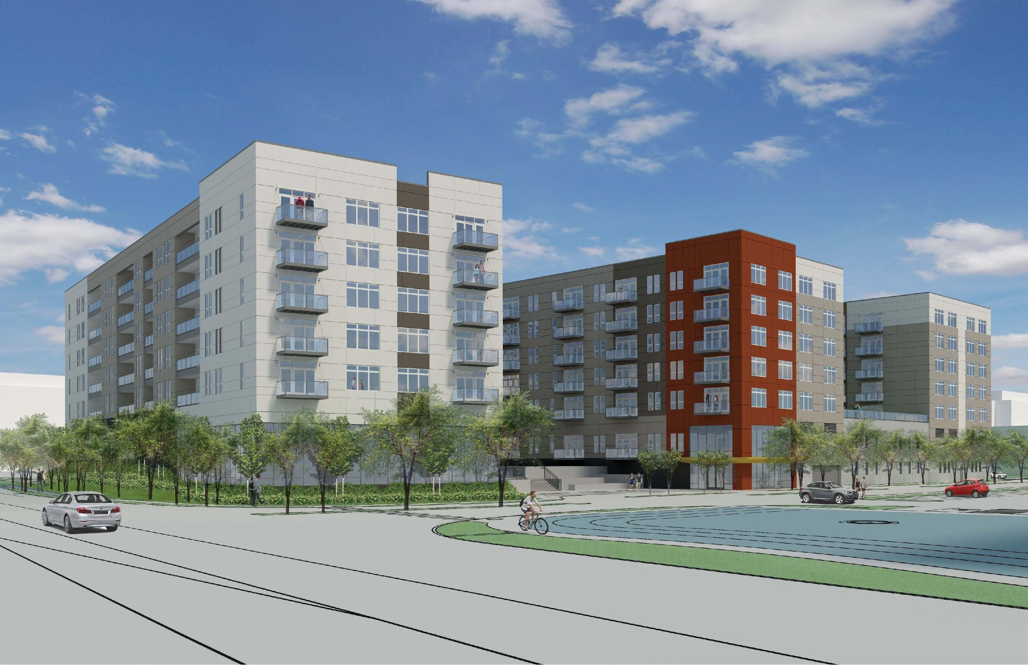
Project Objective
This project seeks to develop an end-to-end data pipeline for affordable housing data to:
Examine data between the location, price, and size of affordable housing developments and standard-of-life features available for tenants.
Foster a better understanding of:
Factors that affect location, prices, amenities, and quality of affordable housing developments.
The distribution of socio-economic indicators, economic activity, access to transit and parks, in each neighborhood.
Potentially identify correlations that may confirm or deny the team’s initial hypotheses related to affordable housing.
Notes:
MC

Slide 4

Business Use Cases
Understanding affordable housing development’s characteristics’ relationship to socio-economic features could be used to develop more conscious policies and drive significant investments that provide inhabitants of affordable housing a better quality of life (i.e. development of additional public transportation in isolated neighborhoods, investment in local businesses, etc.)
Notes:
MC

Slide 5

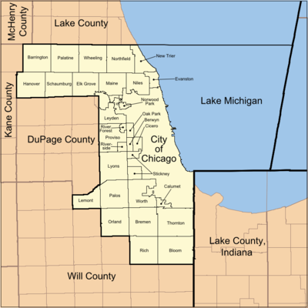
Data
Data sources included:
City of Chicago: Affordable Housing Development Dataset, Business Licenses Dataset, Park Dataset, Abandoned Property Datasets
Zillow and Cook County Records API
Neighborhood Shapefiles and Boundary files for GIS-type applications including generation of Table Keys (Neighborhoods), Public Transit and City Park GIS data points.
Web-Scraping Walk-Scores of Chicago neighborhoods
Notes:
MC

Slide 6
Data Profile
Reviewed data for 428 household developments, 24K units (processed data size)
Raw data size: 88 features, 1.9M rows
Data types used: csv, xls, Shapefiles, Boundary files. Additionally, we used pickle for data preservation. Developed .sql files for DDL/DML, and twbx or Tableau file
Datasets included (the ones in bold were ultimately used): Affordable housing developments, neighborhood shapefiles, abandoned buildings, business licenses, walkscores, neighborhood crime, concentration of rideshares, park location, CTA bus and train stop locations, per capita income, average household size, tax assessments of properties.
Notes:
MAN

Slide 7

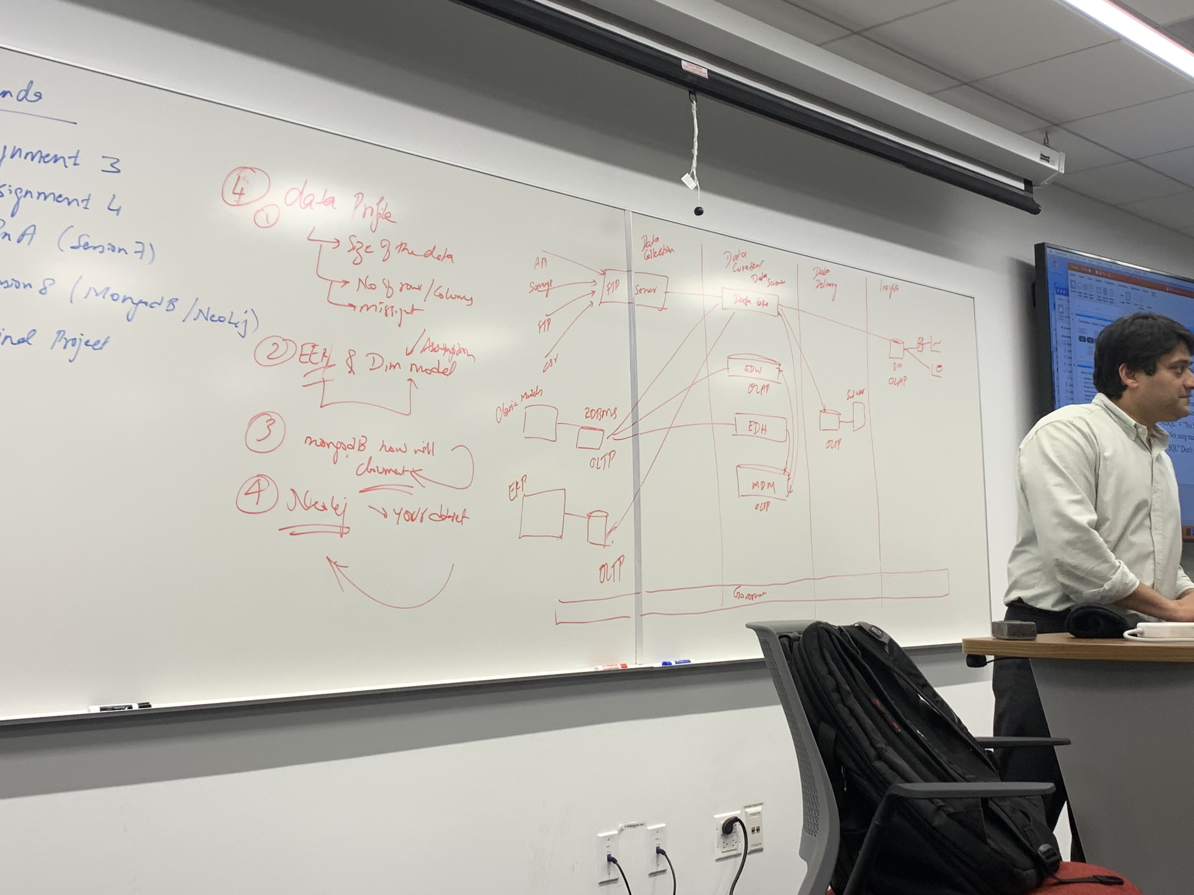
Data Platform
Data Collection
Data Curation /Data Science
Data Delivery
Insights
Cook County API
Data Lake
City of Chicago API
MySQL
City of Chicago Shape Files
MySQL
Zillow API
OLAP
Report for End User
Google Geocoding API
Web Scraping Walk Scores
Governance
Notes:
MAN

Slide 8







Tools
Data was scraped via Python (Walk-Scores), downloaded from online sources (City of Chicago for Housing Developments, Commerce, Park) and gathered using APIs (Google Geocoding, Zillow, Cook County).
Pandas was used for data cleanup.
R was used to build an additional Geocoding API (Google’s) to obtain coordinates from address.
Our data database was built using MySQL. DDL and DML tables were created for each table.
Tableau was used to generate tables and charts to draw insights from our data.
Ingestion and Cleanup
Storage
Delivery and Insights
Notes:
MC

Slide 9
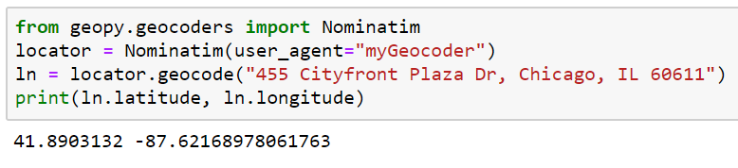
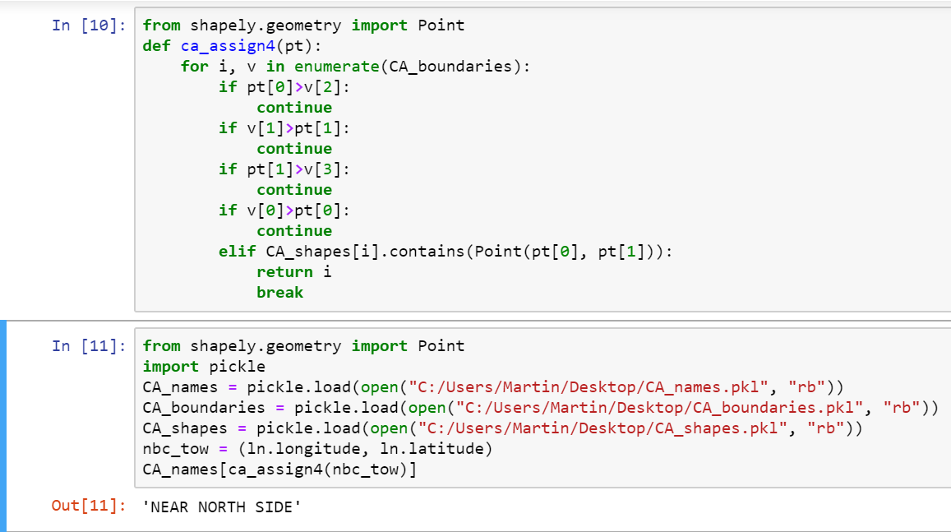
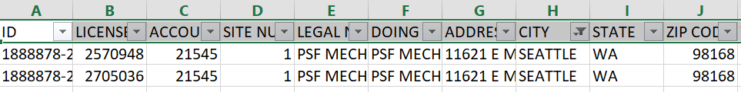
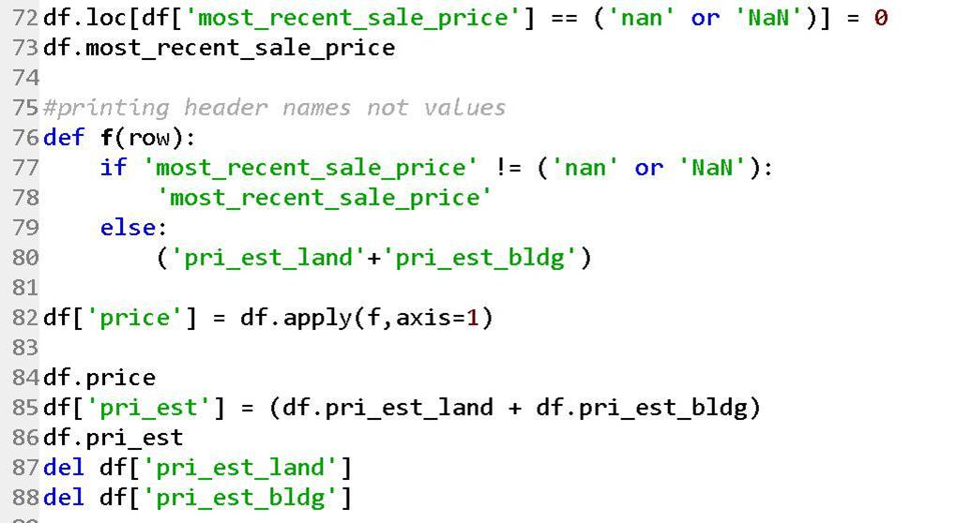
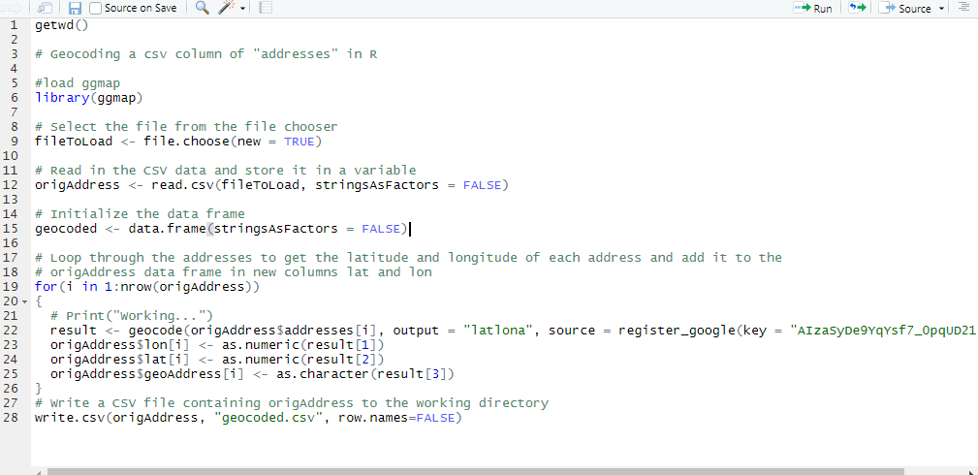
Data Cleanup
GIS Conversions
Out-of-scope Geographically
Overwrote Assessed Value with Sale Value (where available)
Notes:
MF

Slide 10
Design Considerations I: Data
ETL Scripts written in Python and R
Keys were generated for tables (neighborhood from latitude and longitude, or from address):
Chicago neighborhood shapefiles
Geocodes via GeoPy and Google’s Geocoding API via GCP to obtain Latitude and Longitude from address
Web-scraping Walk-Scores to calculate “walkability” of area
Notes:
MF

Slide 11
Design Considerations II: Implementation
Number of tables and joins are not extensive, so this pipeline can be implemented locally given enough disk space
Due to the archival nature of our data, our application can be used as an OLAP system.
Snowflake data model
One to many relationship between individual address and neighborhood requires definition of granularity at neighborhood level
Notes:
MF

Slide 12
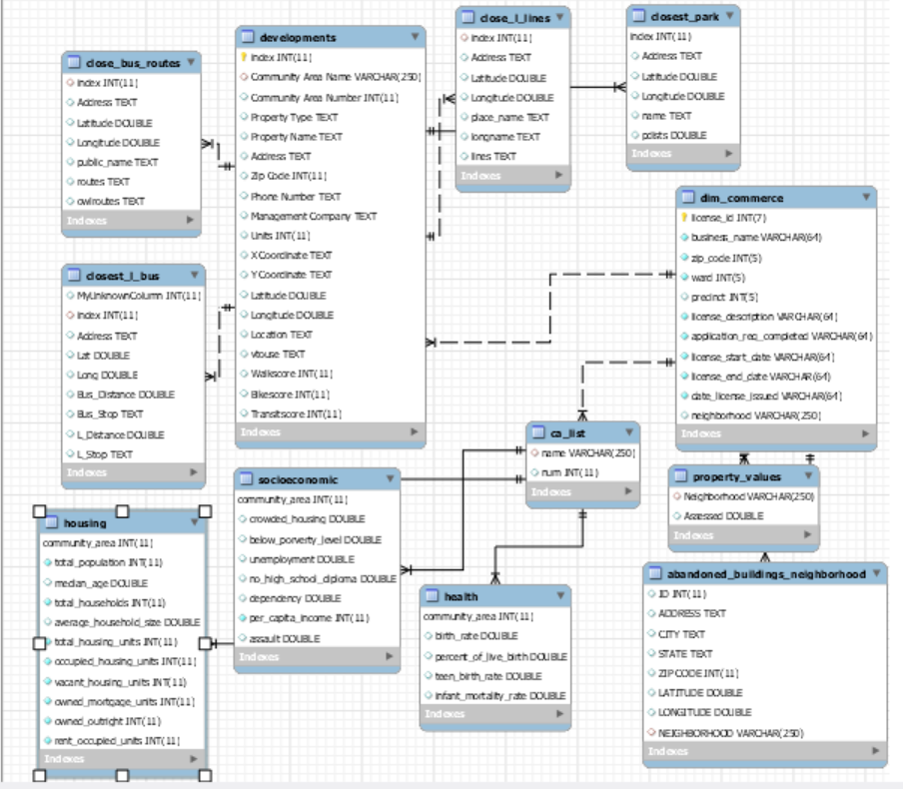
EER Diagram
Notes:
MF

Slide 13
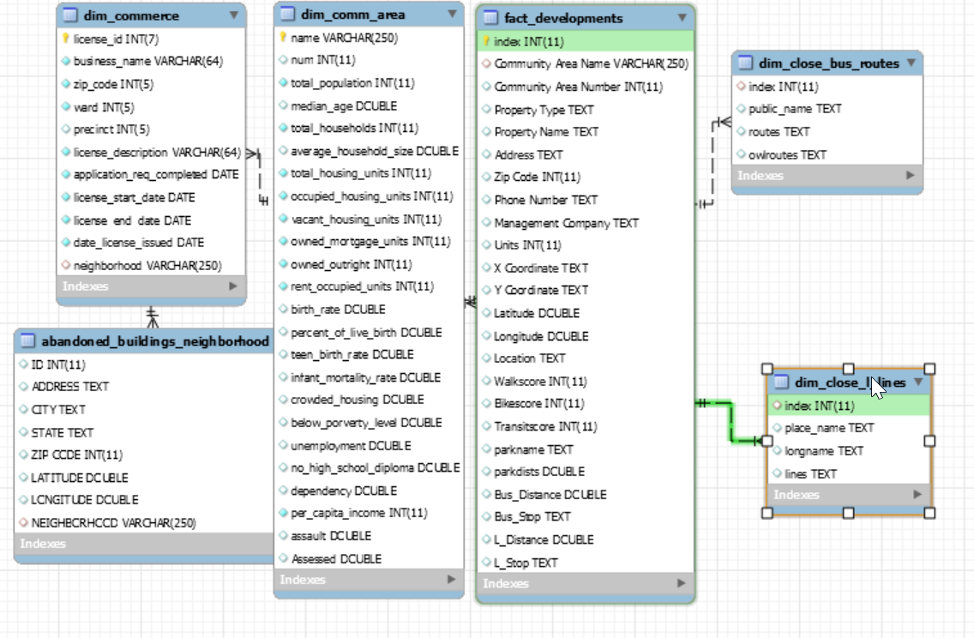
Dimensional Model
Notes:
MF

Slide 14
Preliminary Expectations
Greater number of affordable housing developments
Fewer number of affordable housing developments
In less affluent areas
Near abandoned buildings
In highly-commercialized areas
Near public transit
Near parks
Notes:
MAN

Slide 15
Actual Results
Greater number of affordable housing developments
Fewer number of affordable housing developments
In less affluent areas ✔
Near abandoned buildings ~
In highly-commercialized ~
areas
Near public transit ~
Near parks X
Notes:
MAN

Slide 16
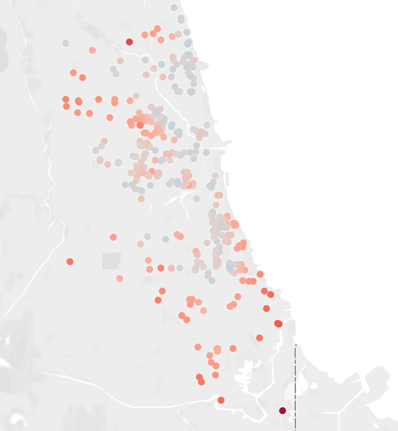
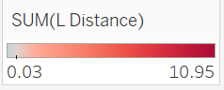
Distance from Housing Developments to One Instance of Public Transportation
Notes:
MAN

Slide 17
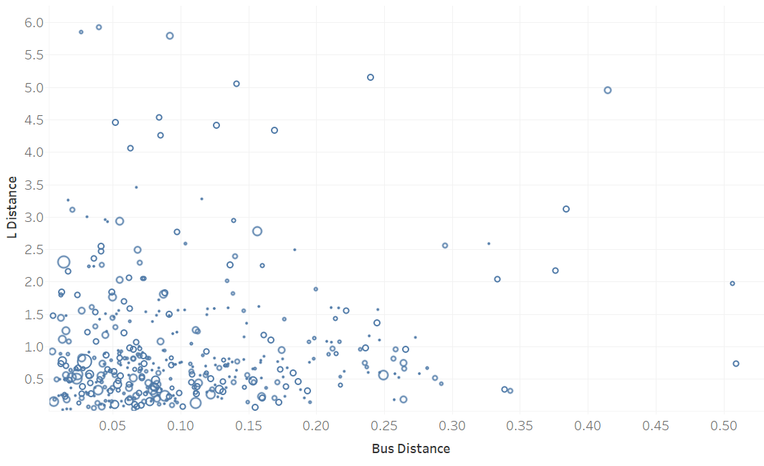
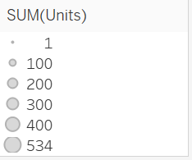
Number of Units by Bus and L Distance
Notes:
The size of dot is number of units, x and y are distance to bus and L respectively. Many have no L access, but bus access is good.

Slide 18
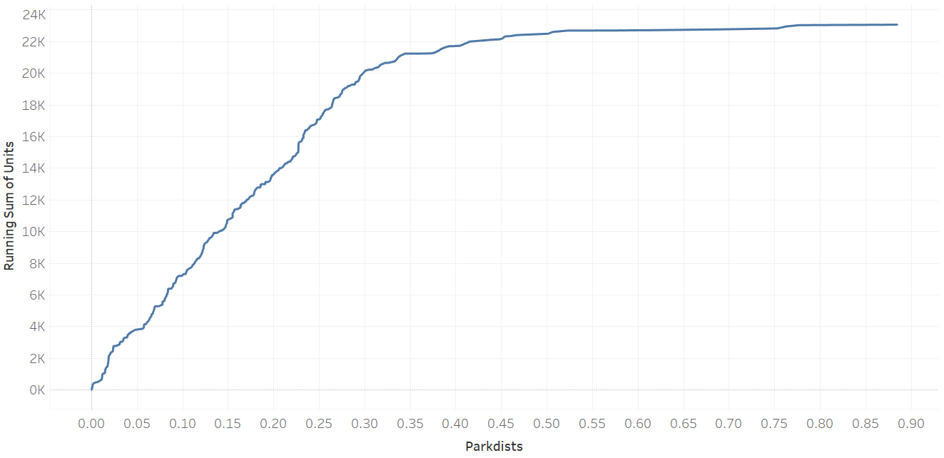
Most units did have access to nearby parks
Notes:
THis is a cumulative sum of number of units by distance to park

Slide 19
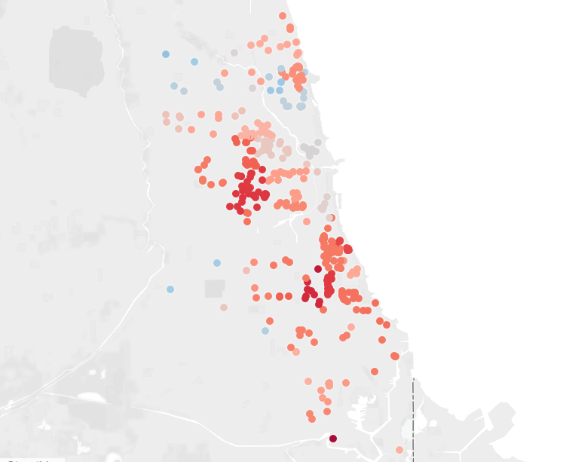
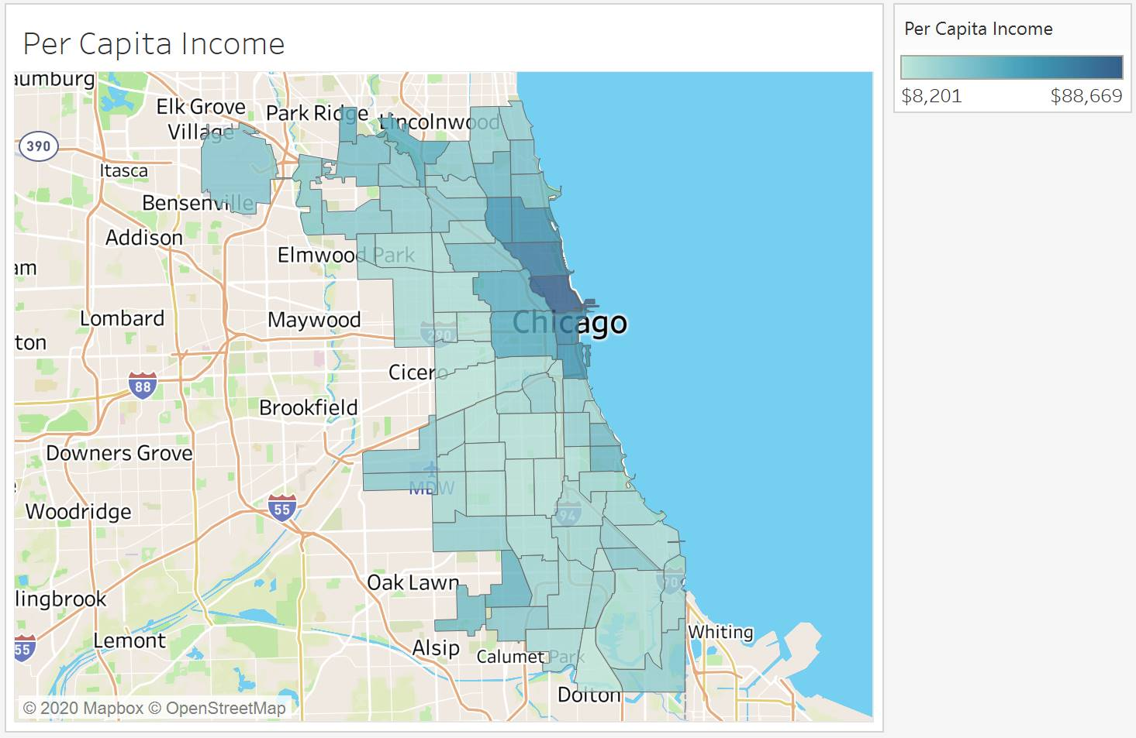
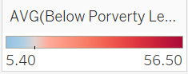
Affordable Housing Developments and Percentage of Neighborhood Below Poverty Line (Centered at 13%)
Notes:
13% is the National avg / Cook county Avg

Slide 20
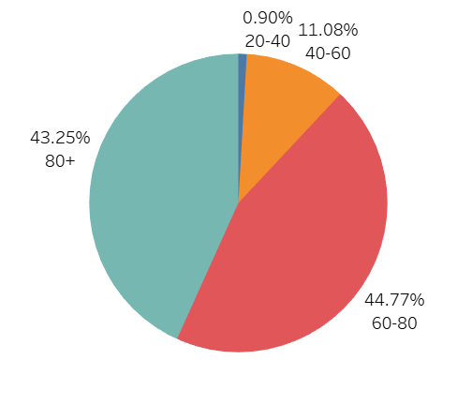
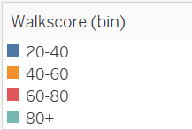
Walkscore (Binned by # of Units)

Slide 21
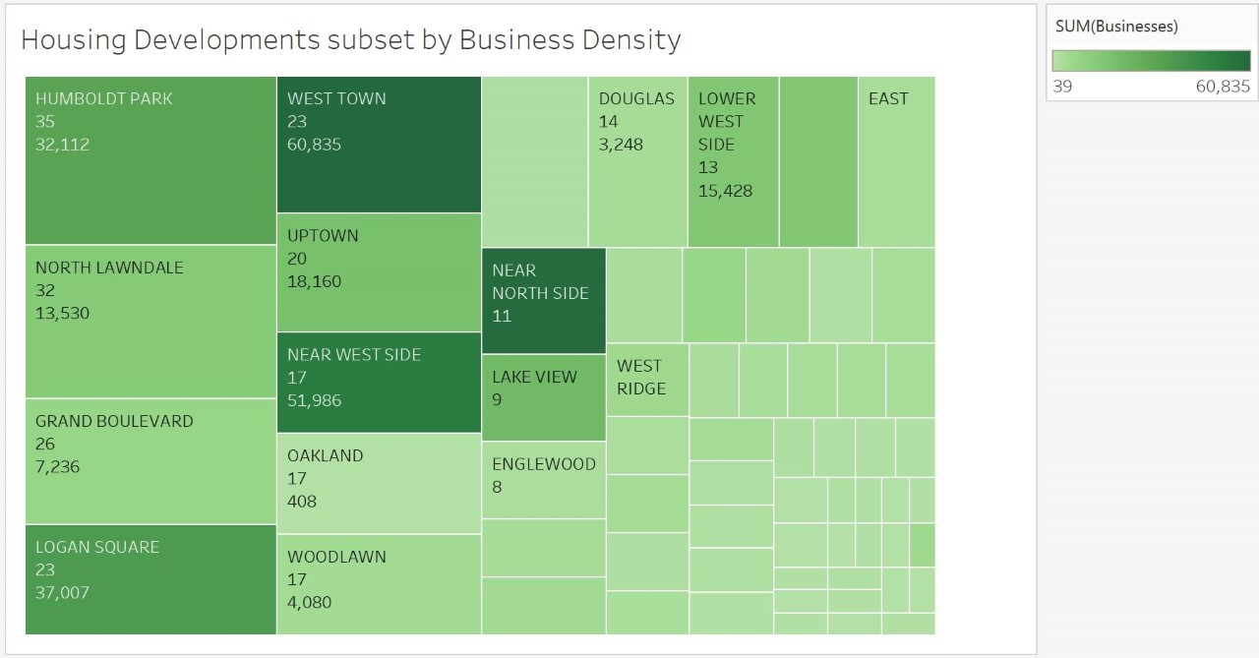

Slide 22
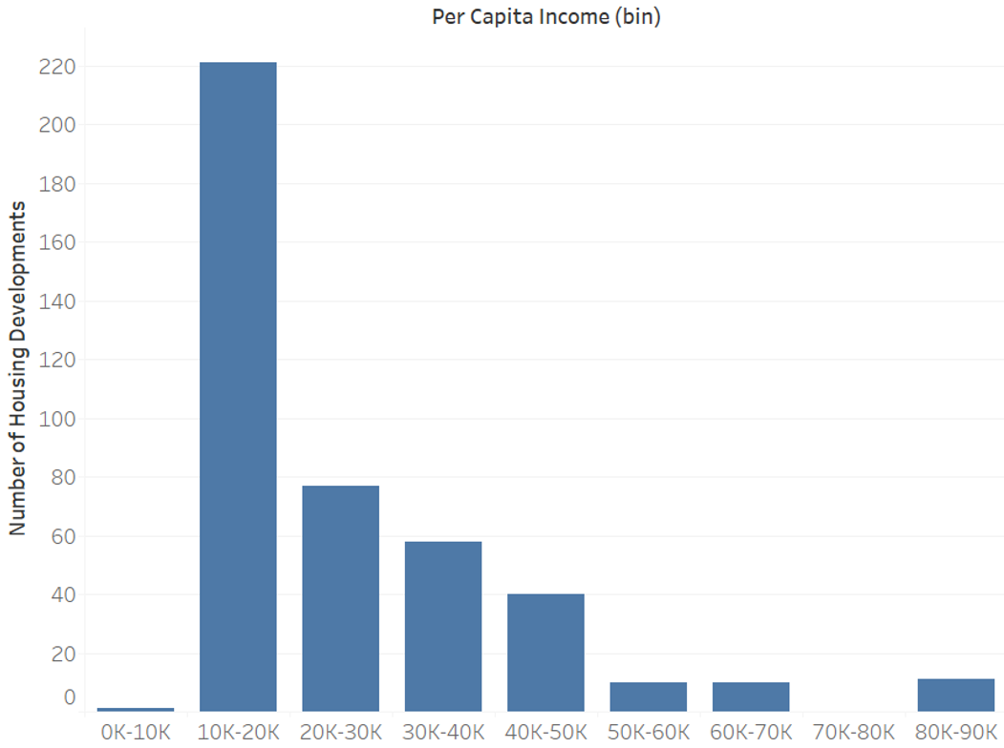
Developments by Per Capita Income

Slide 23
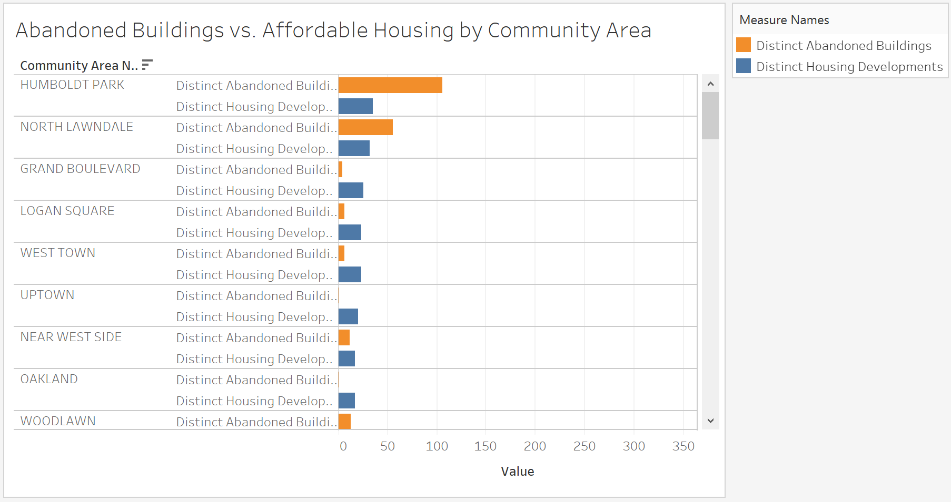
Count of Affordable Housing Developments
Count of Abandoned Buildings

Slide 24
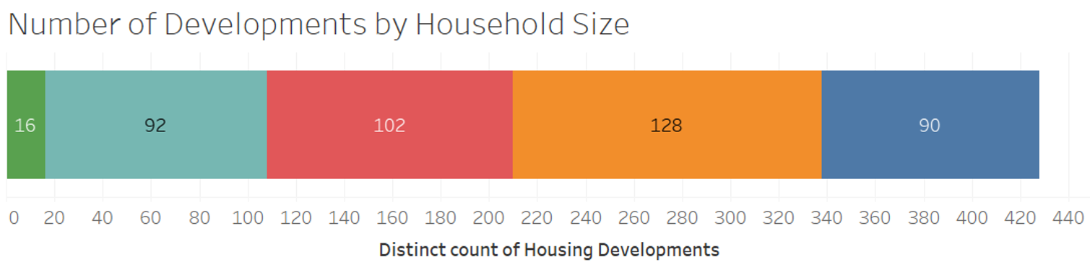
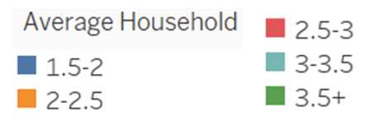

Slide 25
Conclusion
Through the course of the project we discovered strong correlations between the count of affordable housing developments per neighborhood and:
Socioeconomic status of neighborhood, which could perhaps be explained by higher land costs for more affluent neighborhoods
Transit scores of neighborhood for L trains, which could perhaps further isolate neighborhoods with lower household income per capita.
Additionally, weaker correlations were identified between the count of affordable housing developments per neighborhood and:
Business density of each neighborhood
Count of abandoned buildings of each neighborhood
It is difficult to draw conclusions from these weaker correlations.
Notes:
MAN

Slide 26
Areas of Improvement for Project
With enough computing resources and time, further granularity could be utilized to map by-block impacts, driven by the by address level development, assessment, and transportation data, rather than by the neighborhood or area level. This could yield further insight and inform policy by visualizing ripple effects related to affordable housing developments and the blocks in which they are built.
Obtaining data from the 2020 U.S. Census and re-evaluate our findings
Study additional datasets (type of housing, family size, health background, etc.)
Notes:
MAN

Slide 27

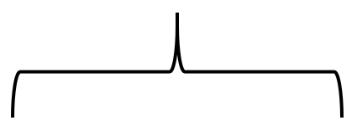
MongoDB
A document database could have served our project well
We would have had one collection, with each document being a development
Many of the attributes, including arrays of nearby L and Bus routes, could have been contained in the document
Within each document, a community area subdocument would be included, with demographic information, and abandoned buildings/commerce for that CA
This would have duplicated some data, but would be efficient
Development Information
Transit Arrays
Community Area
CA demographics
CA abandoned buildings
CA commerce
Notes:
MAN

Slide 28

Neo4J
In a graph database, we would arrange it in the following way:
Each development is a node
Each CA would likely not be included, but just used as a description for the development
This format would not work well for the abandoned buildings and commerce, which would add many nodes and make the database harder to use
Nodes could be connected by distance, but the use case for edges would be limited
Thus, Neo4J would not be an optimal way of representing this data

Slide 29
References
City of Chicago Data Portal: https://data.cityofchicago.org/
Institute for Housing Studies at DePaul University: https://www.housingstudies.org/
Google Maps Platform: https://developers.google.com/maps/documentation
Python for Data Analysis: Data Wrangling with Pandas, NumPy, and IPython 1st Edition by Wes McKinney
Notes:
MAN

Slide 30


